Slide 1
An Interactive Literature Review on Adaptive Traffic Signal with Real-Time Feedback
Team Members
Anuvind Krishna
Jalumedi Shashank Babu
Kamal Johnson
George Thomas

Slide 2
Introduction
Traffic congestion has been one of the major issues that most metropolises are facing in spite of measures being taken to mitigate and reduce it.
There is very little solutions implemented with machine learning which analysis data from the complete transport grid for achieving overall traffic reduction, this technology exploits the real-time traffic monitoring services which are available nowadays.
It will also provide significant data which will help in future road planning and analysis. In further stages multiple traffic lights can be synchronized with each other with an aim of even less traffic congestion and free flow of traffic.

Slide 3
Case Study
Study 1: Kanungo, A., Sharma, A., & Singla, C. proposed Smart traffic lights switching and traffic density calculation using video processing (2014)
Cameras would be capturing video and broadcasting it to the servers where using video and image processing techniques the vehicle density on every side of the road is calculated and an algorithm is employed to switch the traffic lights accordingly.
Peak Time: Density is very high on the roads majorly because of the commuters and as stated in the results Dynamic coded algorithm on average has shown an improvement of about 35% above the Hard Coded system.

Slide 4
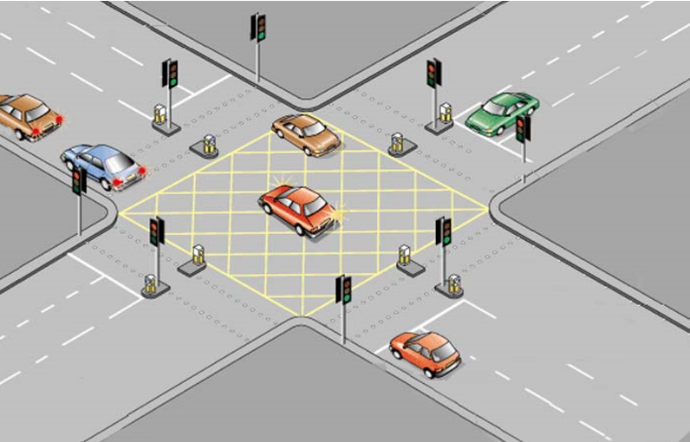
Study 1: Kanungo, A., Sharma, A., & Singla, C. proposed Smart traffic lights switching and traffic density calculation using video processing (2014)

Slide 5
Study 1: Kanungo, A., Sharma, A., & Singla, C. proposed Smart traffic lights switching and traffic density calculation using video processing (2014)
After Sunset or Low Light Conditions: Here the system doesn’t work up to the expectations due to lower light conditions, in that case we could switch over system to hard coded during night time.
This reduce traffic congestion on roads overriding the older system of hard coded lights which cause unwanted delays.

Slide 6
Study 2: Khekare, G.S., Sakhare A.V. proposed VANETs (Vehicular Ad Hoc Networks) (2013)
VANETs provides communication between vehicles themselves and between vehicles and road side units, which can be integrated for creating a smart city.
Continuous broadcasting is done whether any vehicle is in range or not communication is established or not.

Slide 7
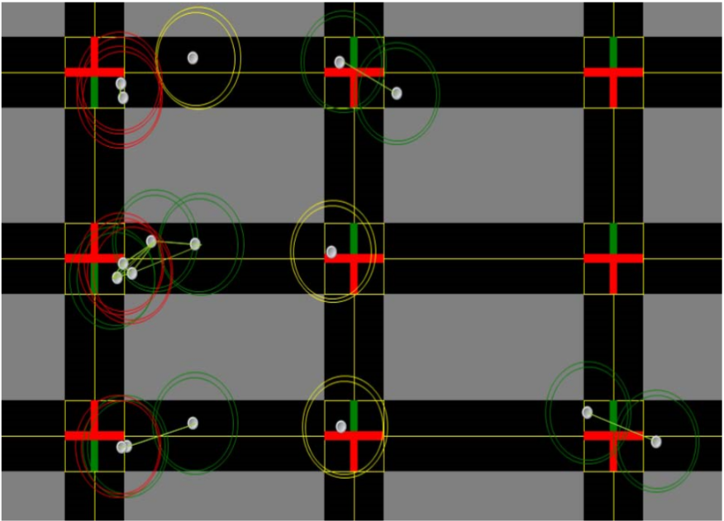
Study 2: Khekare, G.S., Sakhare A.V. proposed VANETs (Vehicular Ad Hoc Networks) (2013)

Slide 8
Study 2: Khekare, G.S., Sakhare A.V. proposed VANETs (Vehicular Ad Hoc Networks) (2013)
Warning message module then sends the data to the traffic density calculation module. Then calculations are made in this module and traffic density of each road is calculated.
This framework of a smart city that will transmit information about traffic conditions and will go a long way in aiding drivers to take spontaneous and smart decisions to prevent themselves from vehicular congestion which will ultimately help in reducing the overall congestion.

Slide 9
Study 3: Badura, S., & Lieskovsky, A. Intelligent Traffic System: Cooperation of MANET and Image Processing (2010)
Badura S., Lieskovsky A. presented a new model for intelligent traffic systems which will encapsulate the features of surveillance via the cameras present on the junction and with the help of data delivery systems let the users access that data. Image Analysis and foreground/background modeling schemes would be the important elements of Surveillance and data transmission over a mobile Ad-hoc network will comprise the data delivery part of the entire system. Various experiments have been conducted in the project and they exhibit great potential in terms of efficiency and real time execution

Slide 10
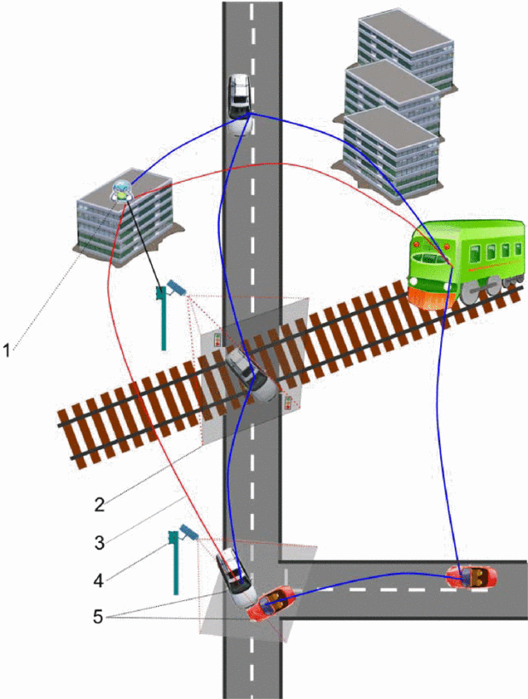

Slide 11
Study 3: (2010)
Salama A.S., Saleh B.K. and Eassa M.M. provide a design of an integrated intelligent system for management and controlling traffic lights with the help of Photoelectric Sensors.
The system uses real-time traffic knowledge to control the traffic lights also provides support for pedestrian crossing and emergency vehicle passing

Slide 12
Salama A.S., Saleh B.K. and Eassa M.M. provide a design of an integrated intelligent system for management and controlling traffic lights with the help of Photoelectric Sensors. With the calculation of the relative weight of each road, the
system will then open the traffic for that road which is more crowded and give it a longer time as compared to the other less congested roads. The real time decision making ability of the system stands out very saliently. Moreover, the system can
also be programmed for emergency scenarios such as passing of presidents, ministries, ambulance vehicles and fire-trucks that require virtually zero congestion through an active RFID based technology. As a result the system will guarantee the fluency of traffic for such emergency cases or for the main vital streets and paths that require the fluent traffic all the time, without affecting the fluency of traffic generally at normal streets according to the time of the day and the traffic density. Also the proposed system can be tuned to run automatically without any human intervention or can be tuned to allow human intervention at certain circumstances.

Slide 14
Study 4: (2009)
Haimeng Zhao, Xifeng Zheng, Weiya Liu presented a design of intelligent traffic control system based on DSP and Nios II.
Their model of intelligent traffic control system deploys dual-CPU combined with the logic control of FPGA (Field Programmable Gate Array)
In order to achieve vehicular congestion it is different from the conventional traffic signal controller in way that it works mostly at the mode of timing and multiple phases according to the user demands dynamically.

Slide 15
Their model of intelligent
traffic control system deploys dual-CPU combined with the logic control of
FPGA (Field Programmable Gate Array) which involves functions like
cross-phase adjustment, exchanging and establishing related information and
live human-computer interaction. In order to achieve vehicular congestion it
is different from the conventional traffic signal controller in way that it works
mostly at the mode of timing and multiple phases according to the user
demands dynamically. Both the hardware and software system are realised in
the paper

Slide 17
Literature Review
Name | Methodology | Advantage | Limits
Khekare, G.S., Sakhare A.V.(Case 1) | VANET’s | Provide communication between vehicles themselves and between vehicles and road side | spontaneous and smart decisions on time would be slower
Badura S., Lieskovsky A (Case 2)
Salama A.S., Saleh B.K. and Eassa M.M (Case 2) | Photoelectric Sensors | Provides support for pedestrian crossing and emergency vehicle passing | poor performance over time and sensors may be fooled
Haimeng Zhao, Xifeng Zheng, Weiya Liu (Case 3) | DSP and Nios II (using FPGA) | Works mostly at the mode of timing and multiple phases according to the user demands dynamically | Occurrence of Starvation in run time
Notes:
Case 2 is used for ambulance and long time traffic density

Slide 18
Summary
The method proposed by us overcomes the limitations of Khekare et.al (study 1) as it is implemented on a junction and has no relation to every automobile that crosses it apart from its vehicle density and as the only hardware employed in our project would be the surveillance cameras at the junctions therefore no need of constant maintenance and less prone to failure as is the case with Salama et.al (study 2) and Zhao et.al (Study 3).
Make efficient traffic signaling based on real time congestion data from google maps reducing the overall traffic congestion, this smart traffic avoidance system will reduce traffic and also reduce fuel consumption which will reduce pollution and overall carbon footprint.

Slide 19
Thank You

Slide 20
Reference
Kanungo, A., Sharma, A., & Singla, C. (2014). Smart traffic lights switching and traffic density calculation using video processing. 2014 Recent Advances in Engineering and Computational Sciences (RAECS).
Khekare, G. S., & Sakhare, A. V. (2013). A smart city framework for intelligent traffic system using VANET. 2013 International Mutli-Conference on Automation, Computing, Communication, Control and Compressed Sensing (iMac4s).
Badura, S., & Lieskovsky, A. (2010). Intelligent Traffic System: Cooperation of MANET and Image Processing. 2010 First International Conference on Integrated Intelligent Computing.

